Slide 1
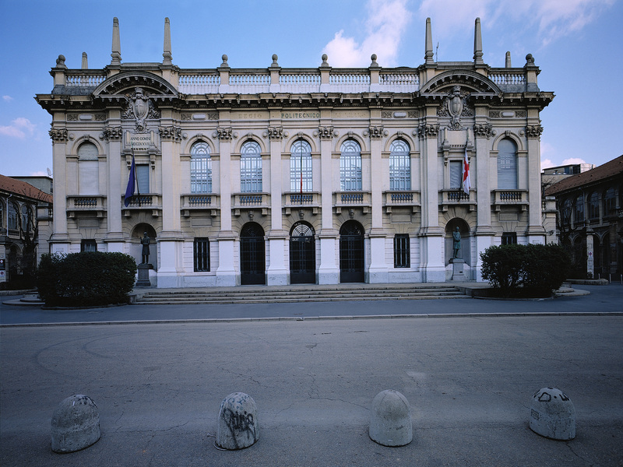

Titolo presentazione sottotitolo
Future Worlds 3D
Milano, XX mese 20XX
Creative Programming and Computing – Project presentation
Students : Harry Foley, Eray Özgünay , Emanuele Greco

Slide 2
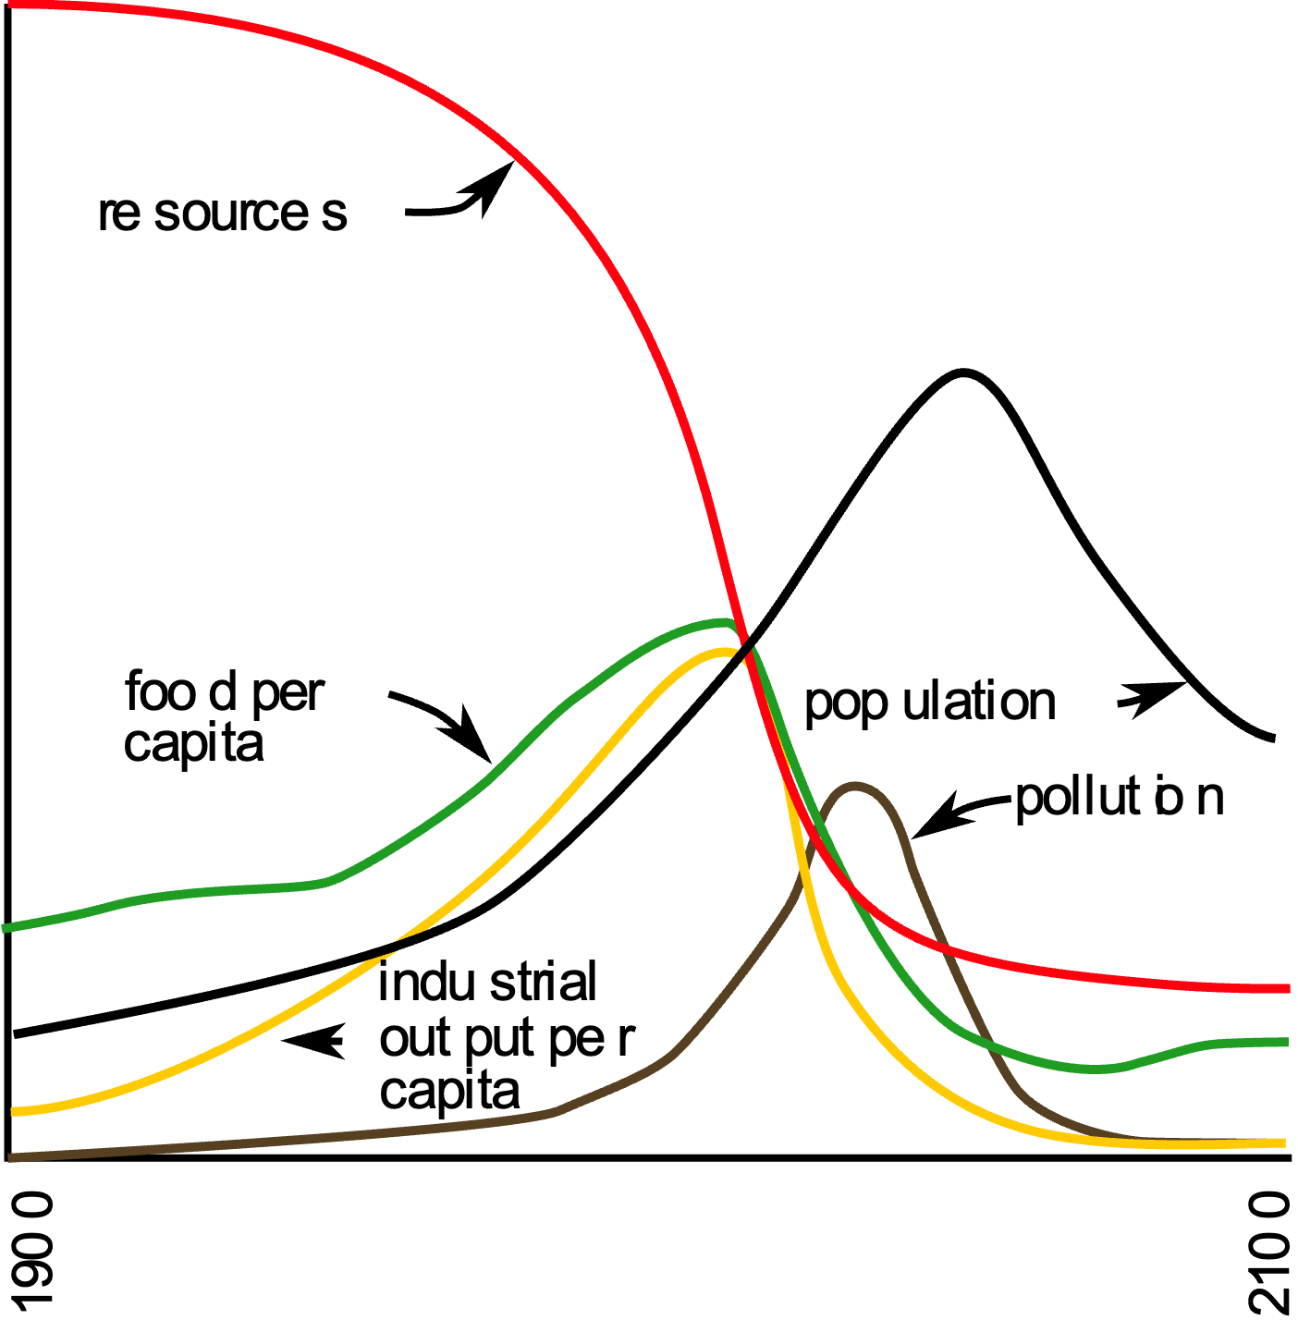
Context
Inpiration
World3 Model from Limits to Growth
Motivation
Promote awareness of our control of our planet's future
Concept
Bring data to life through audio visual creative computing techniques

Slide 3
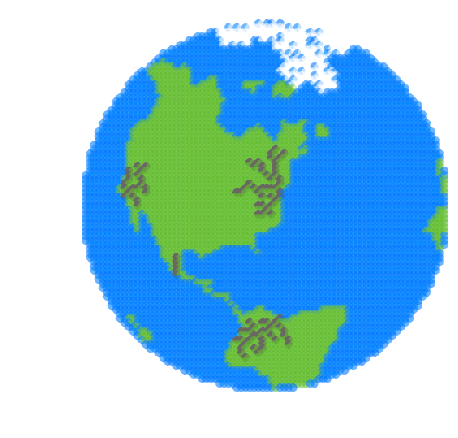

Hackathon
2D representation
OpenCV Edge detection

Slide 4
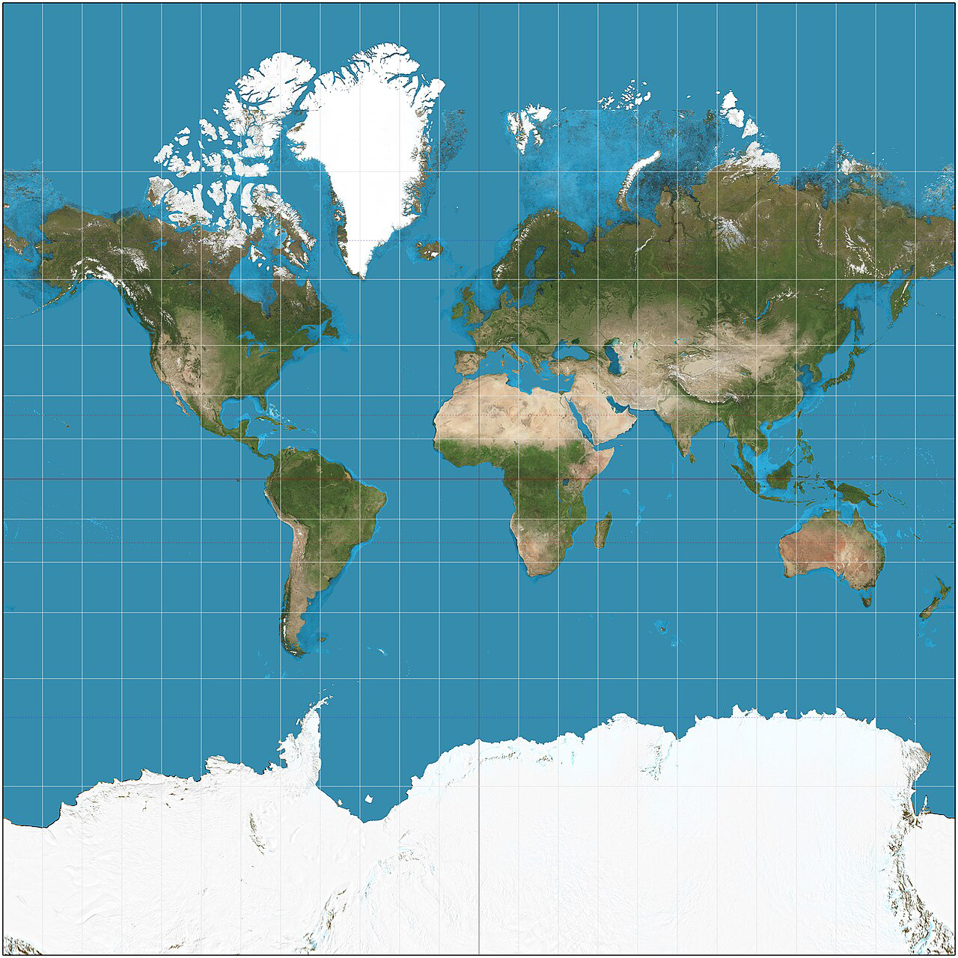
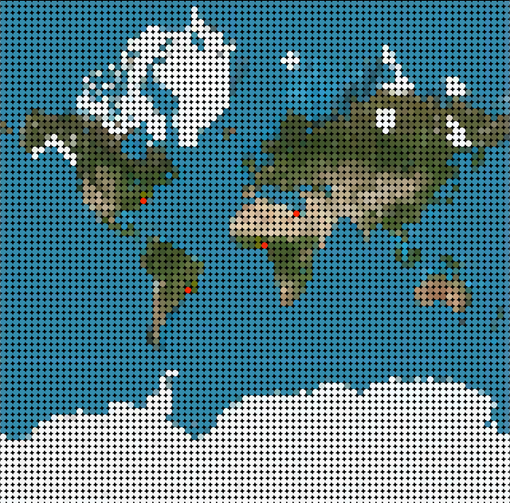
Technical Details: Image Input
Mercator Map to 2D Grid of Cells
Cell Type classified through HSB colour categorisation

Slide 5
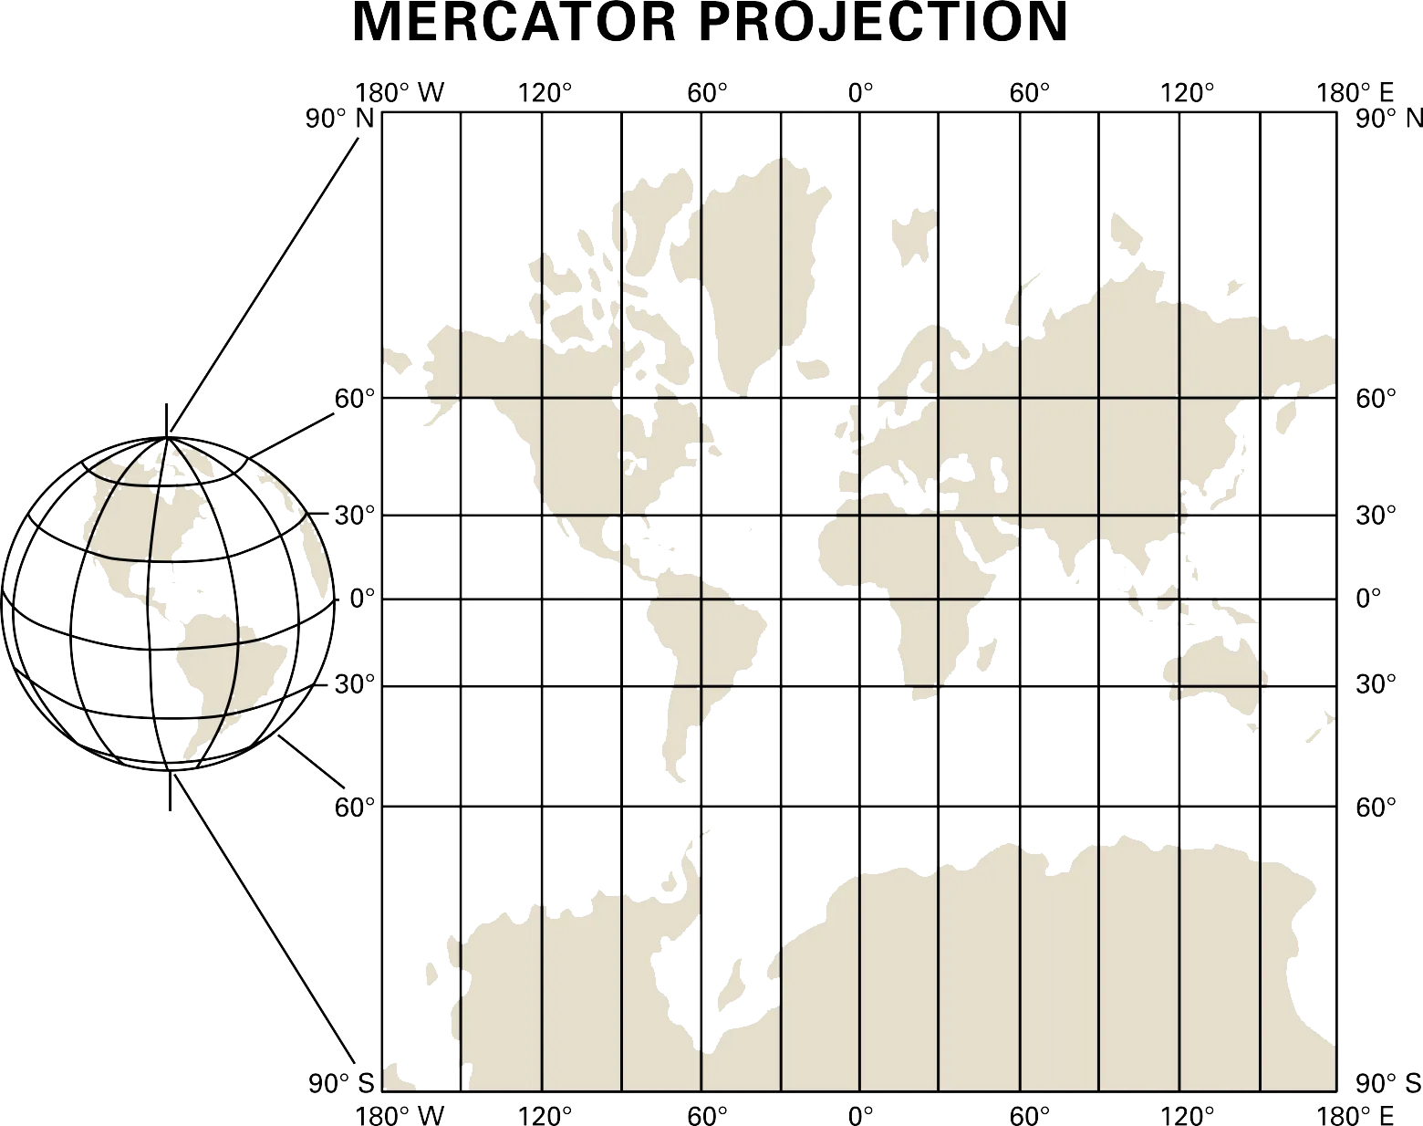
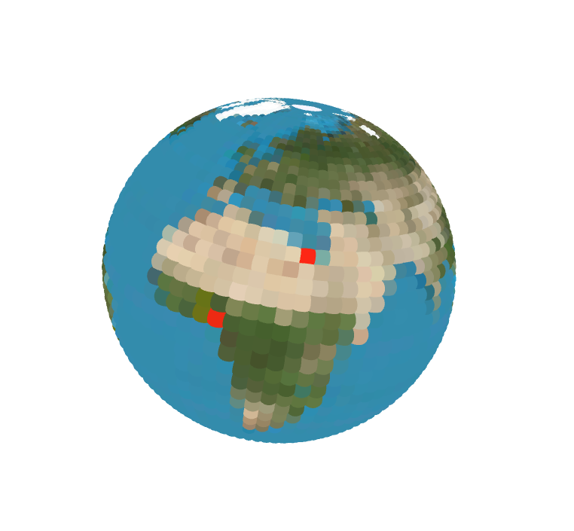
Technical Details: Two Dimensions to Three Dimensions
2D map projected onto a sphere:
(X,Y) of image to (Longitude,Latitude)
(Longitude,Latitude) to Sphere
Cell size scaled by Longitude
Axis rotation through camera movement

Slide 6
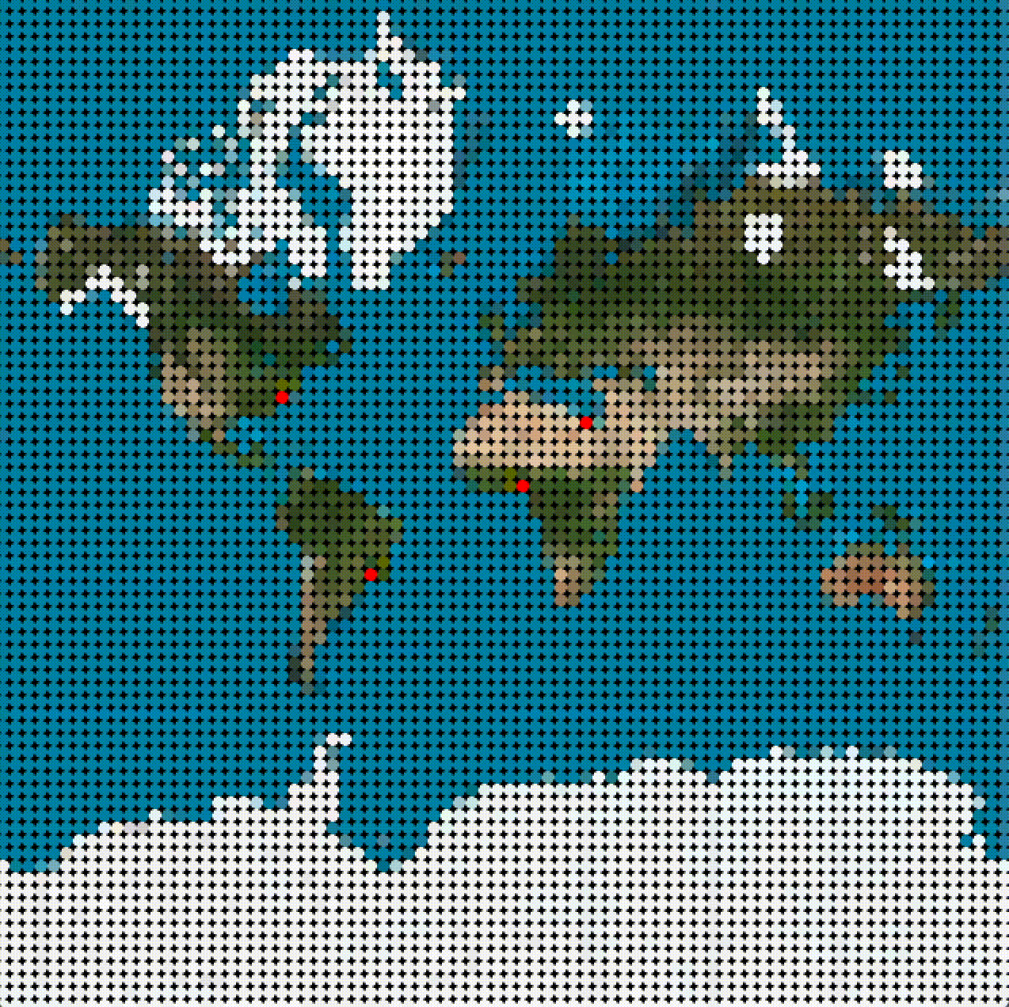
Technical Details: Automa Cellulare
Inspired by Conway's Game of Life
5 cell states to the power of 6400 cells
9 cell interaction rules
Rate of change proportional to time series data
Notes:
2.56 x 10 to the 4473

Slide 7
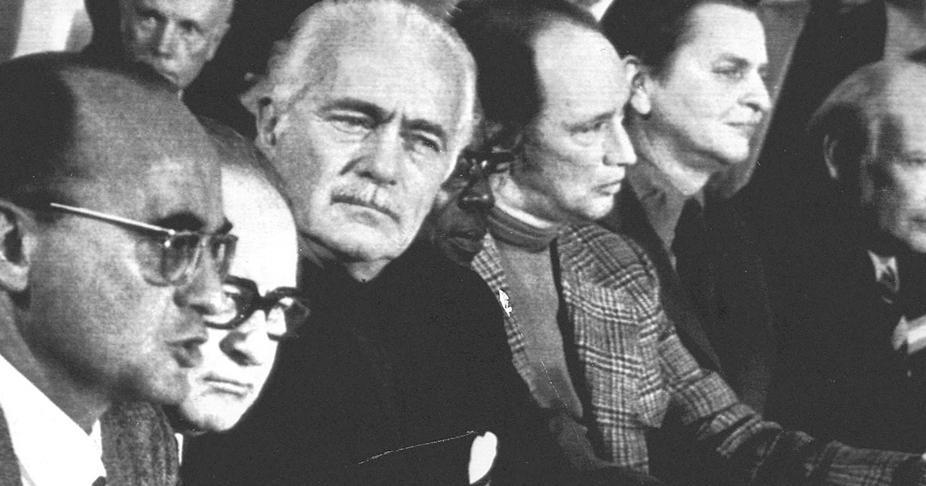
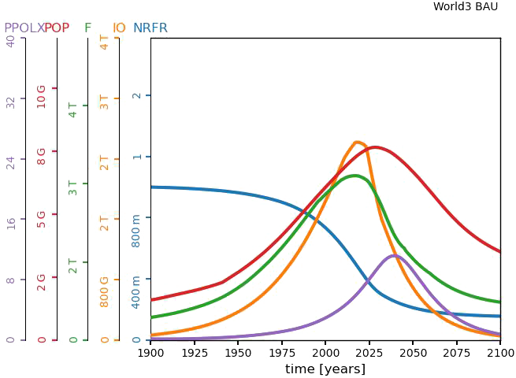
Technical Details: World3 Model
System dynamics model for the simulation of the world’s most important variables and their interaction in the ecosystems of the Earth
Source of time series data
Most convenient scenarios found through the use of a Genetic Algorithm

Slide 8
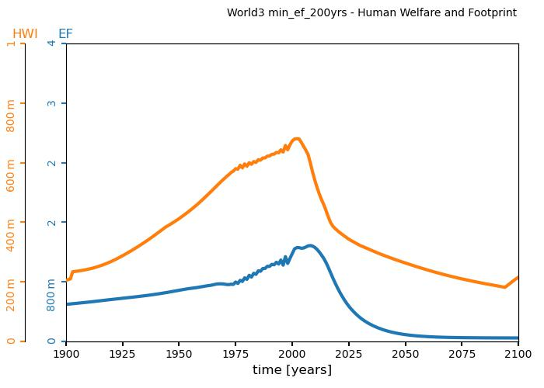
Technical Details: World3 Model
Examples of variables in use:
PPL: Population
F,FPC: Food [vegetable-equivalent kilograms/year], Food per capita
LE: Life expectancy
HWI: Human welfare index
EF: Human Ecological footprint

Slide 9
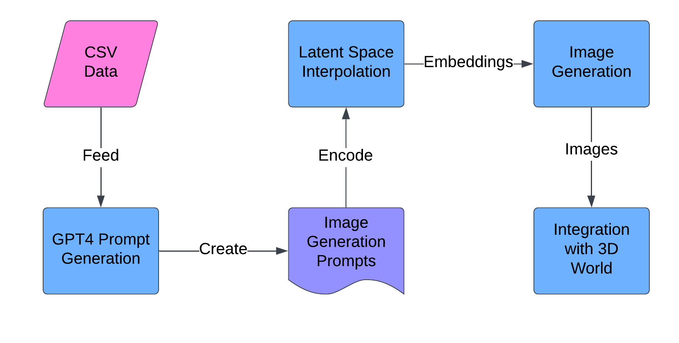
Technical Details: A.I. Image generation
GPT4 + CLIP + small-stable-diffusion-v0

Slide 10




Technical Details: Sound Design
Time series data packaged as OSC Messages
Controlling music and foley sounds in Ableton

Slide 11
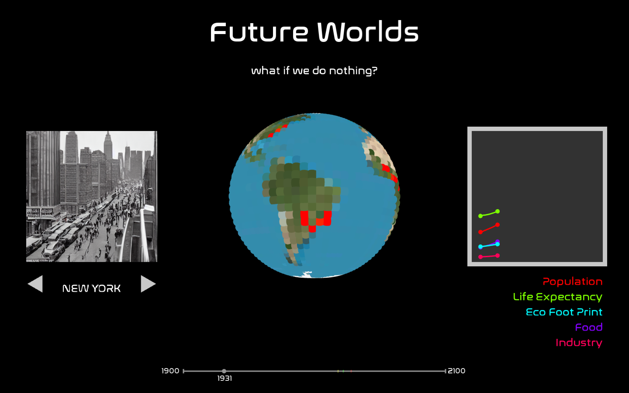
Final Technical Solution

Slide 12
Future improvements
Shaders for higher definition 3D model
Dynamic photo generation
Separate GUI screen

Slide 13
Thank You
Demo

